Slide 1
Connecting the Database to the project

Slide 2
ADO.NET Entity Framework
Entity framework is an Object/Relational Mapping (O/RM) framework
It is an enhancement to ADO.NET that gives developers an automated mechanism for accessing and storing data in the database
Easy to use and saves a lot of work
Can be set up in Visual Studio

Slide 3
Application Architecture

Slide 4


Local Architecture
SQL SERVER MANAGEMENT CONFIGURATION MANAGER START/STOP SERVICE
Instance of SQL Server service must be running
Visual Studio Project
ADO.Net Object
Database
SSMS UI
Attach Database to SQL Server

Slide 5
ADO.Net
Build an Entity Model

Slide 6

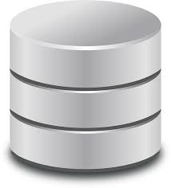

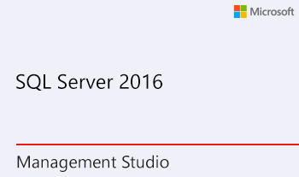
SQL Server Configuration Manager
Windows 10: To open SQL Server Configuration Manager, on the Start Page, type SQLServerManager13.msc
https://docs.microsoft.com/en-us/sql/relational-databases/sql-server-configuration-manager?view=sql-server-2017
Ensure SQL Server instance is running
Visual Studio
ADO.Net Entity DB
Connection Object
Project
Project: DB1
Namespace: DB1.Models
ADO DB Connection grantEntities2
Class Item (Table model)
https://www.microsoft.com/en-gb/sql-server/sql-server-editions-express

Slide 7
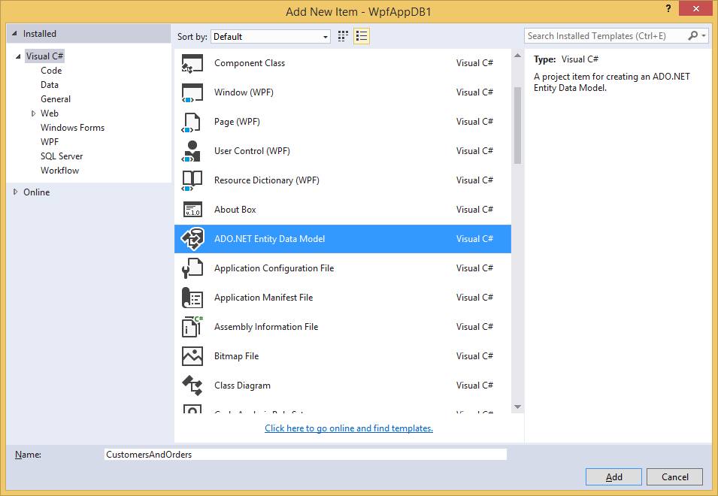
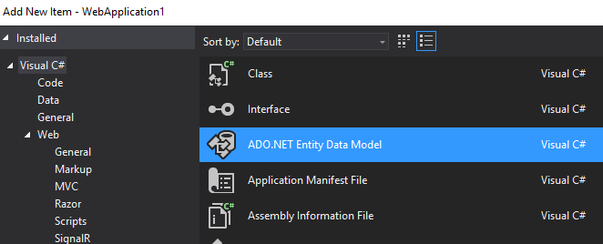
Adding an ADO.NET Entity Data Model
Right-click on the Models folder
Select Add New Item
Select ADO.NET Entity Data Model (either from that menu or from the dialog shown here)
No need to change the model name

Slide 8
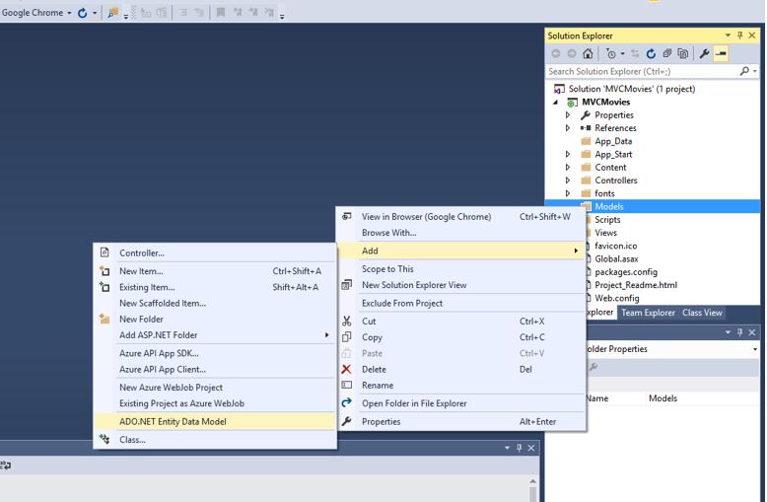
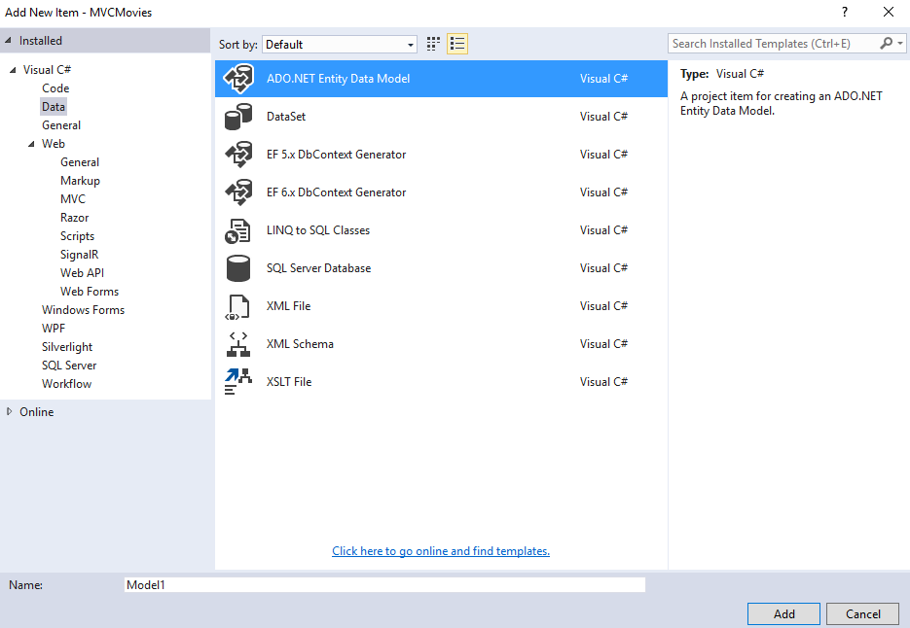
You will need to add an ADO.NET Entity Data model to your project to link your database to your project
In the Solution Explorer, right-click on the Models folder
Select Add New Item
Select ADO.NET Entity Data Model from the menu
If it’s not on the menu, select Add New Item and then select ADO.NET Entity Data Model from the dialog shown here (you may have to select Data on the left-hand side of the dialog)
Click OK to start creating the model. There’s no need to change the model name

Slide 9
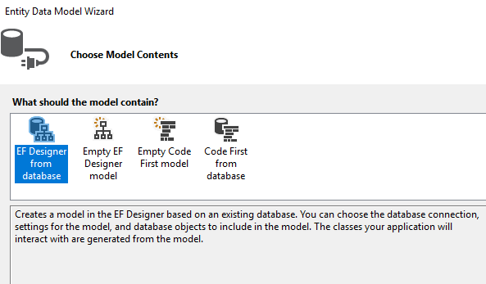
Select EF Designer

Slide 10
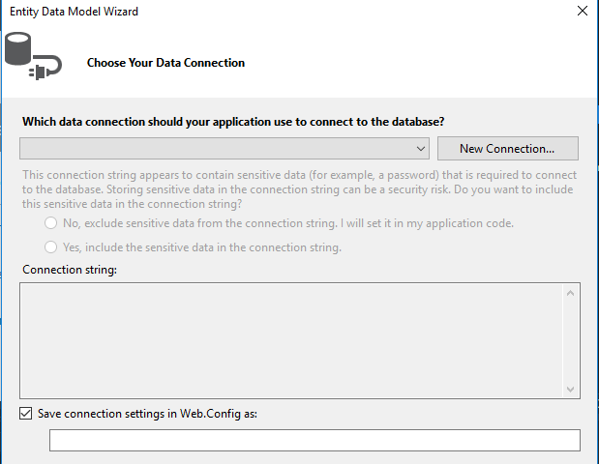
Add new Connection

Slide 11
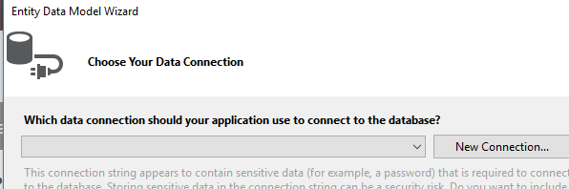
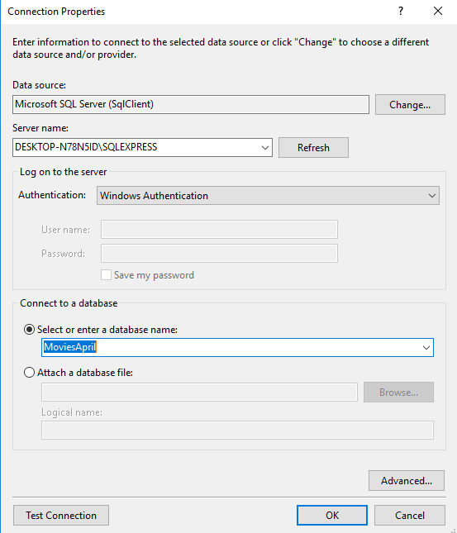
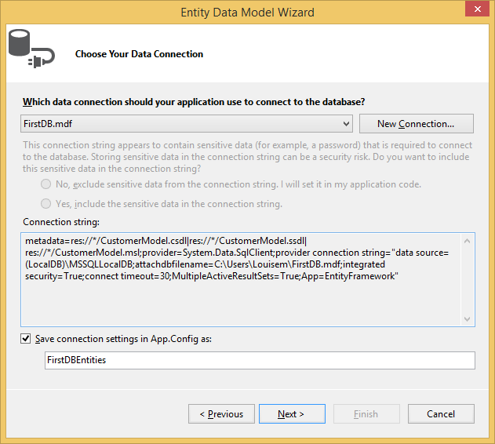
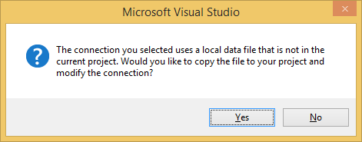
Connect to the SQL Database

Slide 12
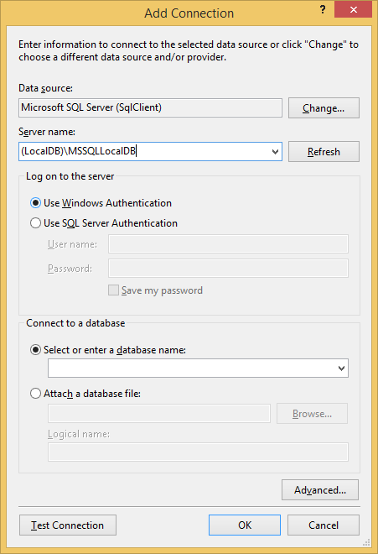
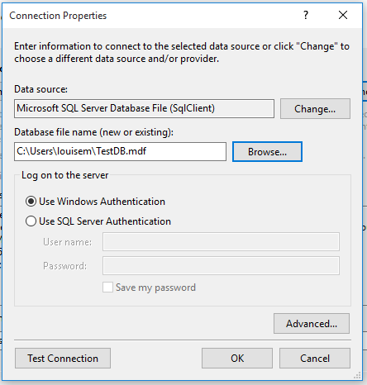
Two options for connecting to a DB here – try the one below first
Same DB as we used to
log in to SSMS
Put the DB filename here
Then click Test Connection – if you get a green tick, then click OK

Slide 13
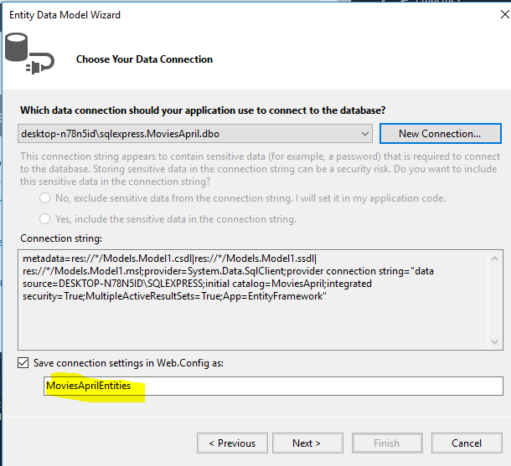
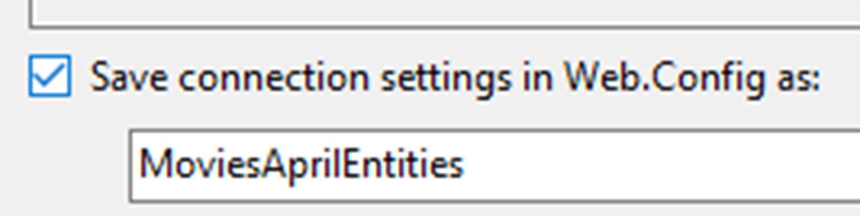
Entities Model created (DatabaseNameEntities)

Slide 14
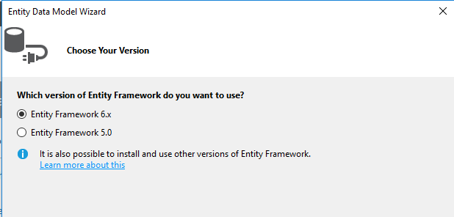
Select Framework

Slide 15
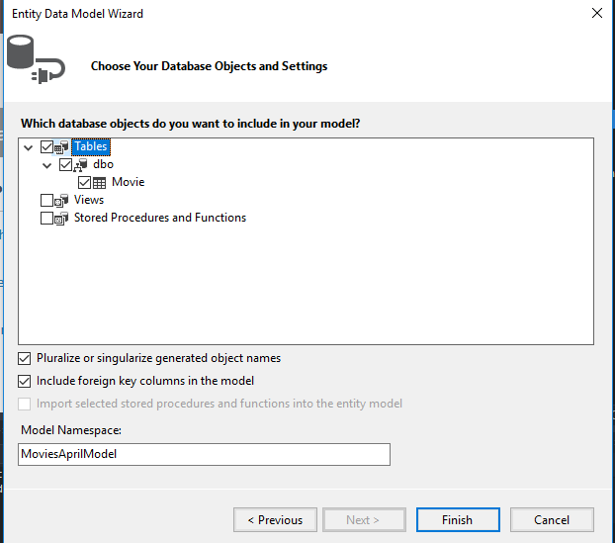

Select the Database Objects to be part of the model

Slide 16
ADO.Net Entity Model is then created
Checks
Model
Controller

Slide 17
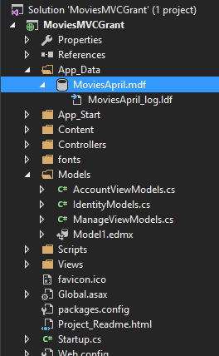
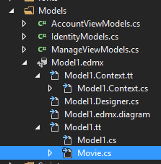
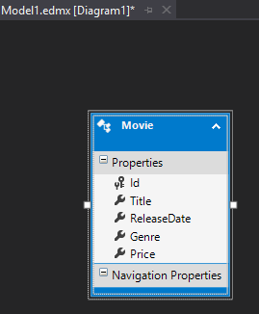
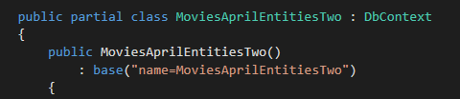

Slide 18
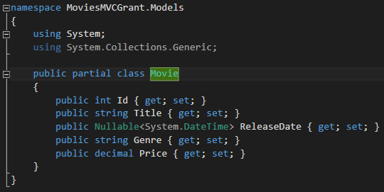
Movie

Slide 19
Database and Model now connected into the project and can be accessed through the codebase

